Slide 1
Analysis of Stayzilla Dataset
Shubham GuptA – pes1201801295
Manah Shetty – pes1201801733
Darshan pirgal – pes1201801832

Slide 2
Properties On Stayzilla - Columns
Amenities
City
Image Count
Occupancy
Property Type
Room Price
Room Types

Slide 3
Packages used
tidyr
stringr
rworldmap
reshape
tigerstats

Slide 4
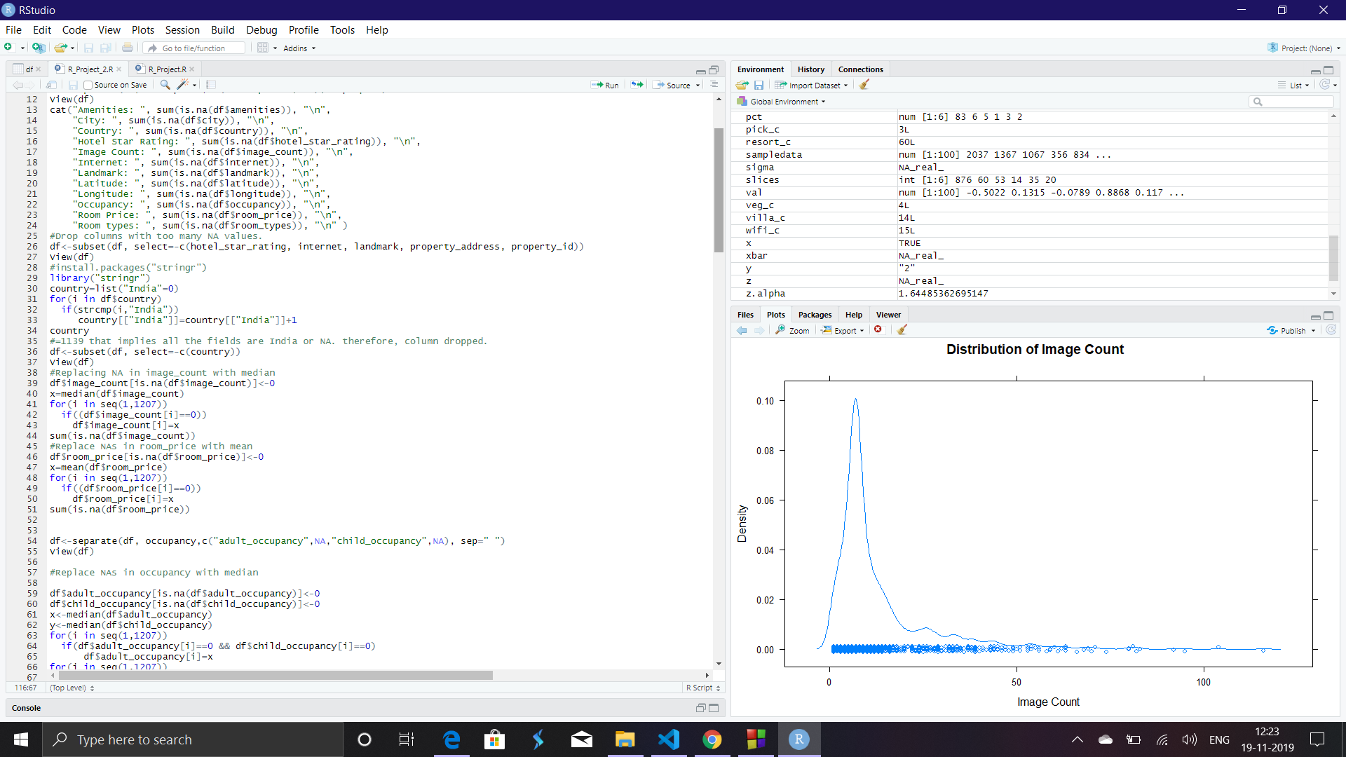
Data Cleaning

Slide 5
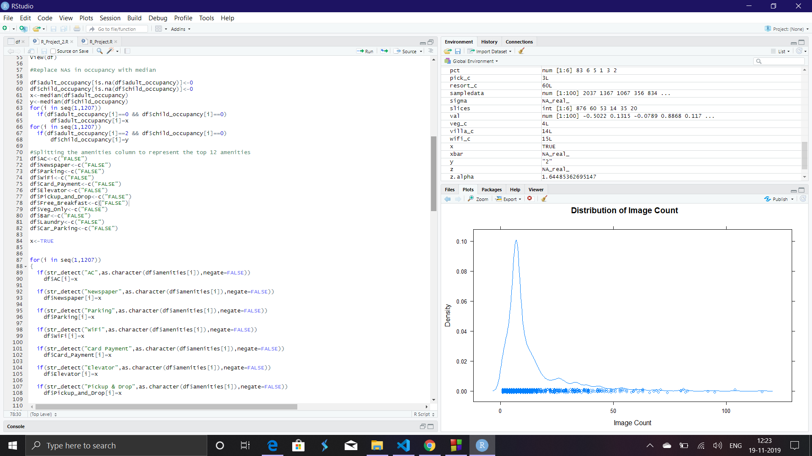

Slide 6
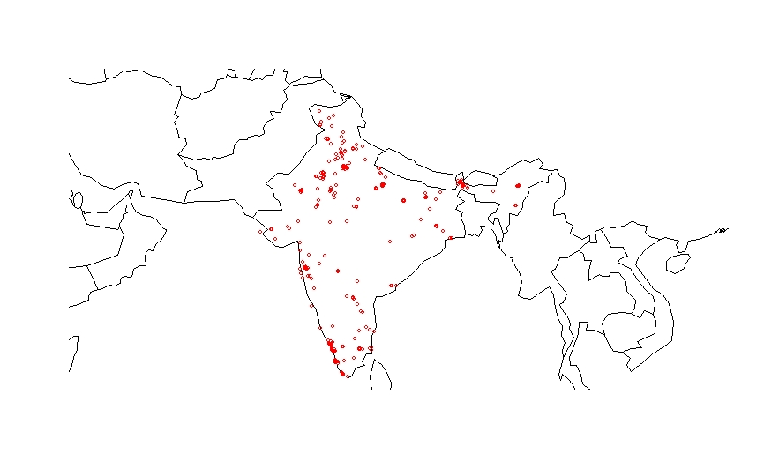
Visualizations

Slide 7
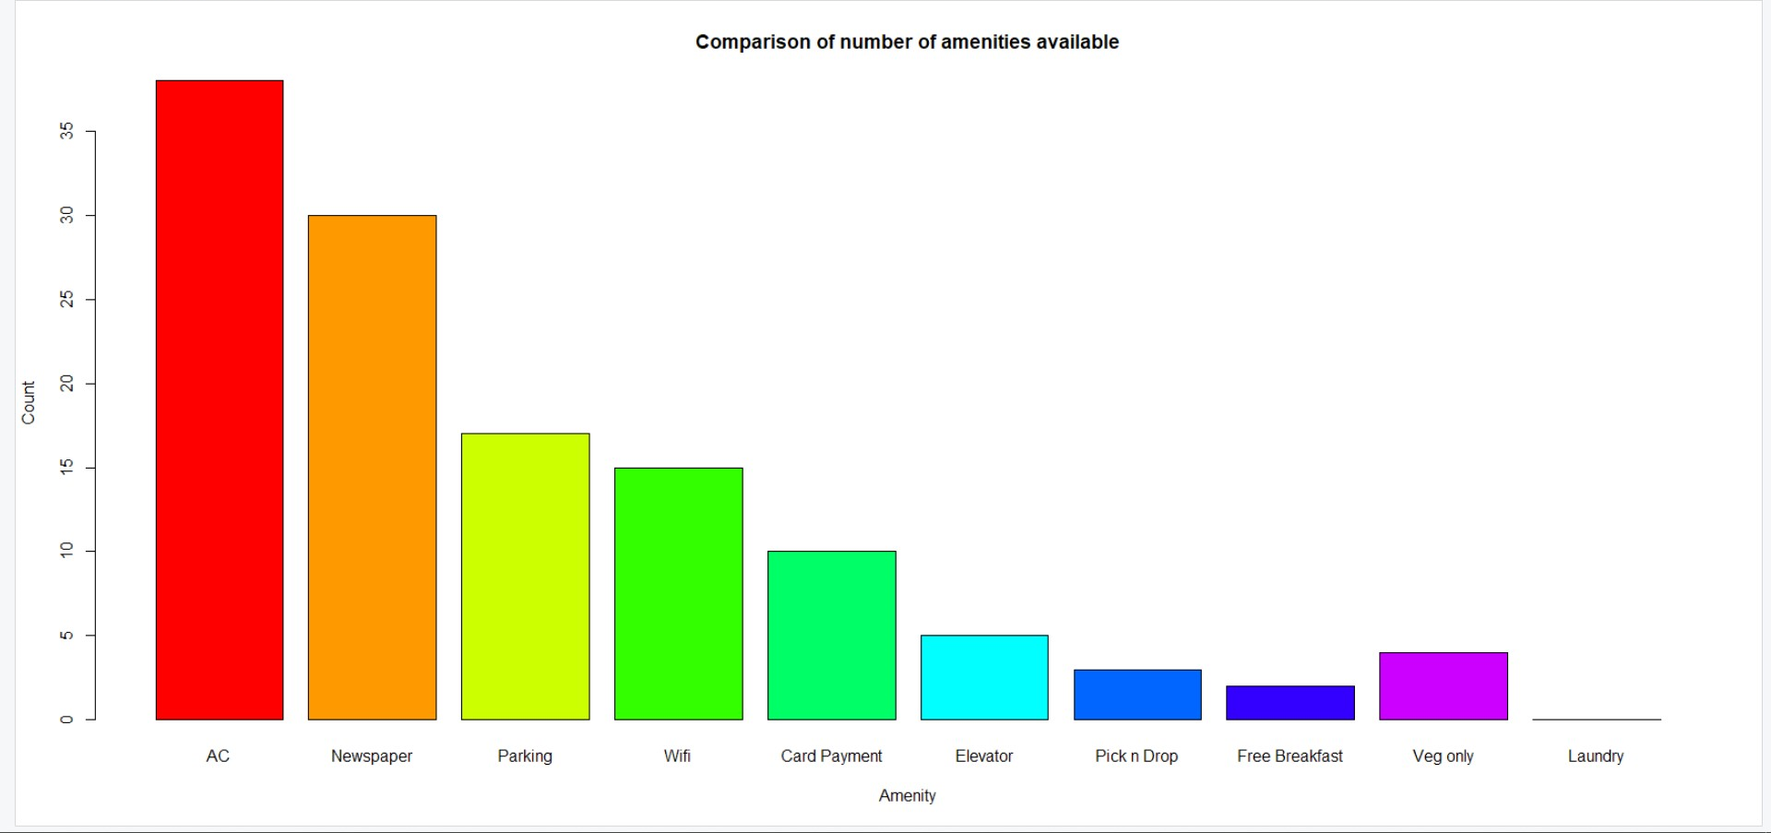

Slide 8
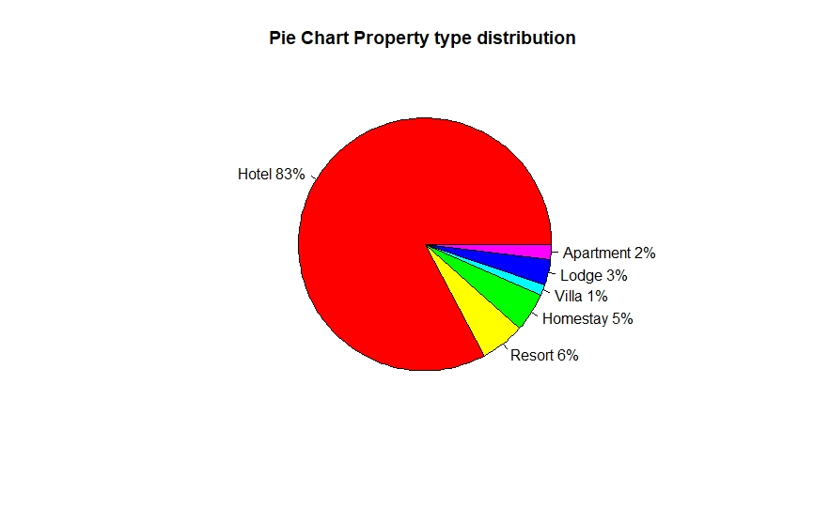

Slide 9
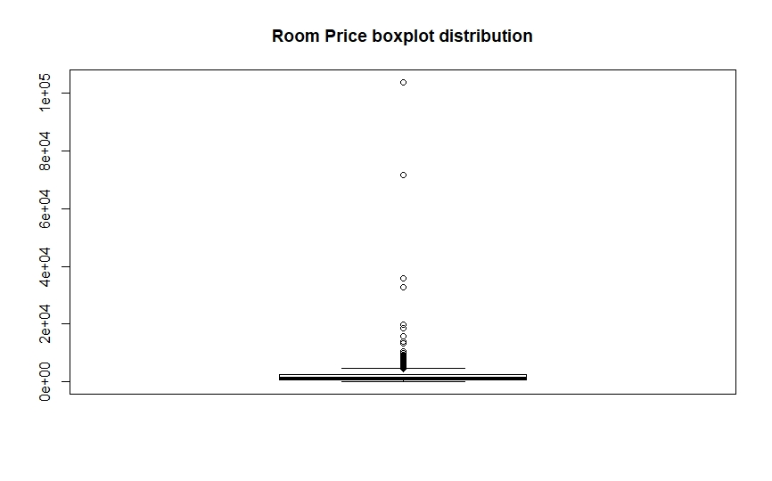
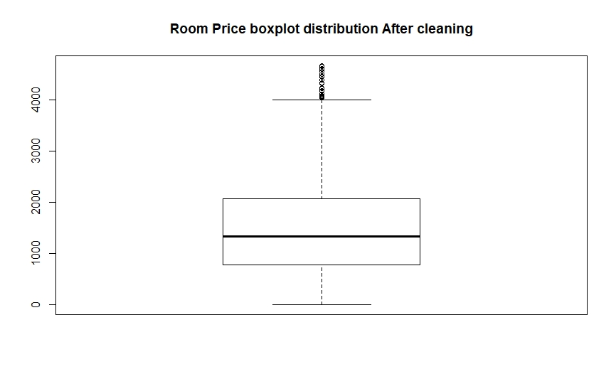

Slide 10
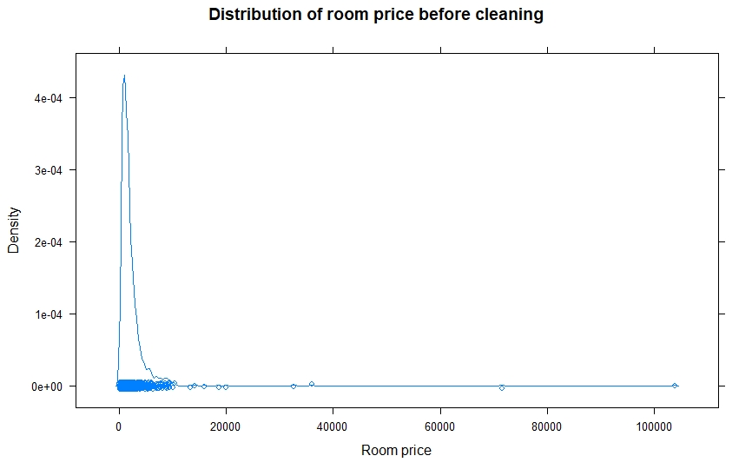
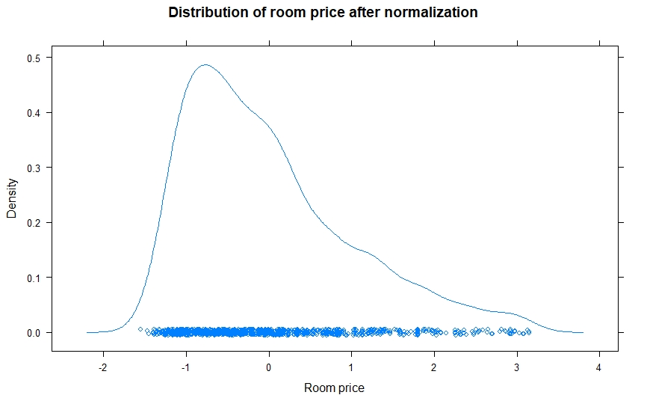
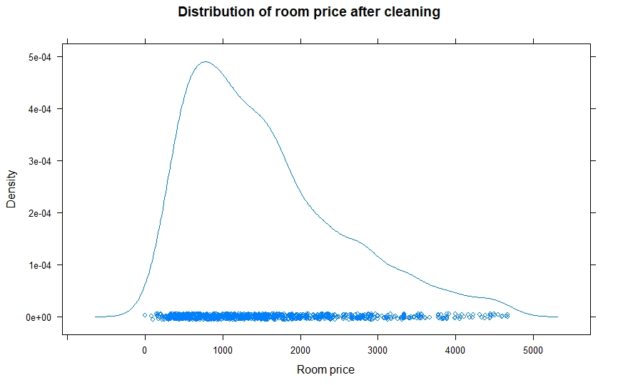

Slide 11

Hypothesis Testing
H0 : mean room price <= 1300
H1 : mean price > 1300
Null Distribution : xbar ~ N(1492.951, ${946.9995}^{2} )$

Slide 12
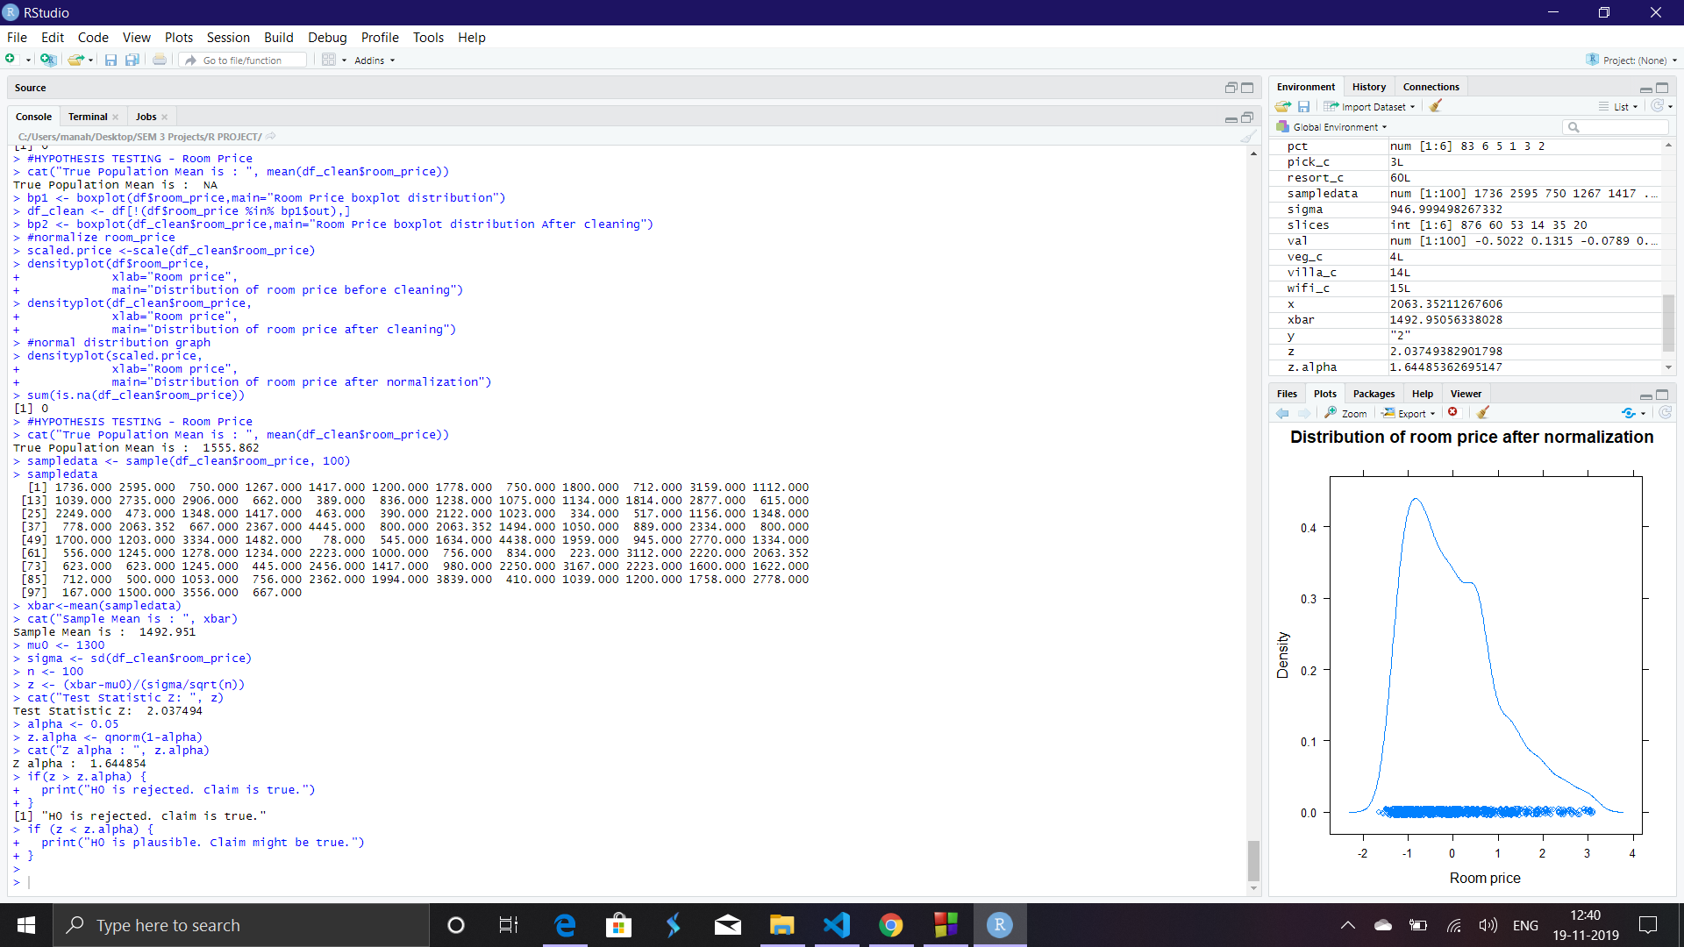

Slide 13
THANK YOU !!!

